Slide 1
F# MVC for WPF
Dmitry Morozov
DEC 27, 2013

Slide 2
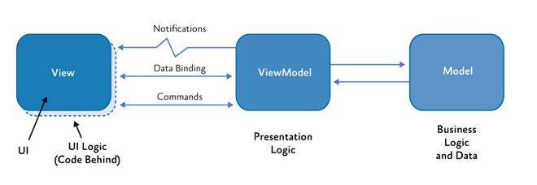
MVvm (Model-View-ViewModel)

Slide 3
Can we do better in F#?
MVVM has many shortcomings
It’s still hard to develop WPF apps using MVVM
MVVM was designed with C# limitations in mind

Slide 4
FIRST class Event-Driven architecture
//Numeric up-down control
type View = IEvent<Events>
and Events = Incr | Decr
type Model = { State : int }
type Controller = Model -> Events -> Model
type Mvc = Controller -> Model -> View -> Model

Slide 5
FIRST class Event-Driven architecture – C#
//Numeric up-down control
using View = IObservable<Events>;
enum Events { Incr, Decr };
class Model
{
public Model(int state) { this.State = state; }
public int State { get; private set; }
}
delegate Model Controller(Model model, Events @event);
delegate Model Mvc(Controller controller, Model model, View view);

Slide 6
MVC not Mvvm

Slide 7
model
Not domain model
Based on Castle Dynamic Proxy
Raises INPC.PropertyChanged from setter interceptor
Restrictions: virtual properties + base class + factory method +parameterless ctor
DECLARATIVE, FUNCTIONAL STYLE
Type definition only, no imperative logic
It is better to have 100 functions operate on one data structure than 10 functions on 10 data structures.

Slide 8
VIEW
type IView<'Events> =
inherit IObservable<'Events>
abstract SetBindings : obj -> unit
Event source
Data binding target (model is the DataContext)
F# support for .NET events makes experience really smooth
DU is better than Enum (pattern matching, extra state)

Slide 9
Model – subset of view state
View
Model
Data binding

Slide 10
Controller
type IController<'Events, 'Model> =
abstract InitModel : 'Model -> unit
abstract EventHandler : ('Events -> 'Model -> unit)

Slide 11
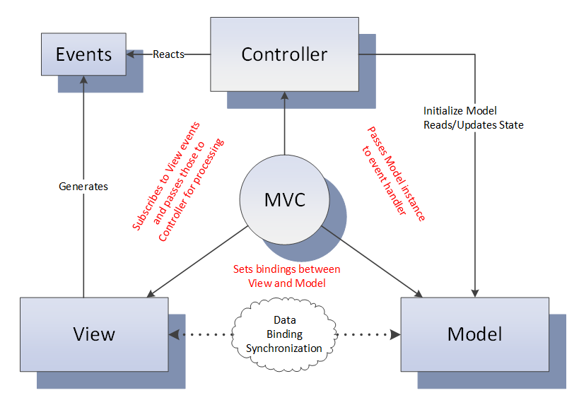
MVC – gluing pieces together
YOUR PRESENTATION LOGIC HERE

Slide 12
Data binding
type IView<'Events, 'Model> =
inherit IObservable<'Events>
abstract SetBindings : 'Model -> unit
<@ textBox.Text <- model.Name @>
textBox.SetBinding(TextBox.TextProperty, "Name")
Making implicit dependency explicit
Leveraging F#/.NET type system
Leveraging IDE/compiler

Slide 13
Validation
Statically-typed
Would be verbose without F# language features:
Active patterns
Explicit member constraints
Partial application

Slide 14
Async
“Async in C# and F#: Asynchronous gotchas in C#” blog post by Tomas Petricek
type IController<'Events, 'Model> =
abstract InitModel : 'Model -> unit
abstract EventHandler : ('Events -> 'Model -> unit)
type EventHandler<'Model> = 'Model -> unit
type IController<'Events, 'Model> =
abstract InitModel : 'Model -> unit
abstract EventHandler : ('Events -> EventHandler<'Model>)
type EventHandler<'Model> =
| Sync of ('Model -> unit)
| Async of ('Model -> Async<unit>)
type IController<'Events, 'Model> =
abstract InitModel : 'Model -> unit
abstract Dispatcher : ('Events -> EventHandler<'Model>)

Slide 15
Child Windows
Dialog – synchronous computation
Non-modal window - asynchronous

Slide 16
Reentrancy
Very tricky problem

Slide 17
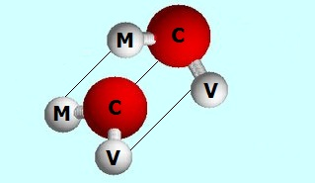
composition

Slide 18
External event sources
As easy as composing views
Rx.NET helps to ensure invocation on GUI thread
Another composition option

Slide 19
Data binding micro dsl
Scrap your boilerplate
F# gives great tools to build internal DSLs

Slide 20
Derived properties
Scrap your boilerplate
F# pure magic
ReflectedDefinitionAttribute
Quotation
Active patterns (a lot)
WPF black magic
MultiBinding

Slide 21
F# 3.0/.net4.5
Queries
Type providers
WSDL
XAML
INotifyDataErrorInfo
ExceptionDispatchInfo
Arbitrary binding expressions

Slide 22
INPC type Provider

Slide 23
F# MVC for WPF
No INPC boilerplate model
Abstract polymorphic view
Loosely couple controller
Type checked event to handler mapping
Statically typed data-binding DSL
Lightweight validation
Type system supported Async
Dialogs/Windows as sync/async workflows
Reentrancy problem solved at one place
COMPOSITION
External event source
Declarative derived properties
Queries, type providers …
All components replaceable/optional except IView, IController and MVC

Slide 24
TO DO
F# open source project
Docs
Nuget package
Visual Studio Project Template
Windows Phone
WinRT

Slide 25
In summary
F# great general purpose language
Hard things easy impossible things possible
Go thru the framework code base – it’s great language tutorial
GitHub project: http://github.com/dmitry-a-morozov/fsharp-wpf-mvc-series
Wiki: http://github.com/dmitry-a-morozov/fsharp-wpf-mvc-series/wiki

Slide 26
SQL Command type provider
Statically typed access to T-SQL script input/output
Compare to
Dapper
EF, LINQ to SQL
Generating Strongly Typed DataSets
Part of F# Community Project Incubation Space
http://github.com/fsprojects

